Slide 1
Q Learning

Slide 2
Q- Learning
The key idea behind Q-learning is for an agent to learn a policy, which is a strategy that guides its actions in different states of the environment.
Q-learning is typically applied to a specific problem where an agent interacts with an environment. The environment consists of different states and allows the agent to take certain actions in those states.
When the agent performs an action in a particular state, it receives a numerical reward (r) from the environment. The reward provides immediate feedback to the agent about the goodness of its action.
The Q-value Q(s,a)) of a state-action pair is an estimate of the expected cumulative reward the agent can obtain, starting from state s, taking action a, and then acting optimally thereafter. Initially, these Q-values are usually set arbitrarily.
The Q-table is a data structure used to store and update the Q-values for each state-action pair. It starts with initial values and is updated through learning.
The Q-learning algorithm iteratively updates the Q-values based on the rewards obtained and the transitions between states. The updates are typically done using the Q-learning update rule mentioned in the previous response.

Slide 3
The agent faces a trade-off between exploration (trying new actions to discover their effects) and exploitation (choosing actions based on current knowledge to maximize rewards). Properly balancing this trade-off is crucial for effective learning.
The learning rate (α) determines the extent to which new information replaces old information in the Q-table during updates.
The discount factor (γ) indicates the importance of future rewards in the agent's decision-making.
The Q-learning process continues until the Q-values converge to optimal values, ensuring that the agent has learned the best policy to maximize rewards.

Slide 4
Q Table
A Q-table, short for Quality table, is a fundamental data structure used in Q-learning, a popular reinforcement learning technique.
The Q-table helps an agent learn and make decisions in a discrete state-action space.
It is a matrix where each row represents a state, each column represents a possible action, and each cell stores the corresponding Q-value.
The Q-value Q(s,a)) in the Q-table for a specific state-action pair (s,a) represents the expected cumulative reward the agent can achieve by starting in state s, taking action a, and then following an optimal policy.
Initially, the Q-table is usually initialized with arbitrary or zero values.

Slide 5
Here's a simple example of a Q-table for a hypothetical problem with two states (State 1 and State 2) and three possible actions (Action 1, Action 2, Action 3):
| State | Action 1 | Action 2 | Action 3 |
|--------|-------------|-------------|------------|
| 1 | 0.5 | 0.2 | 0.1 |
| 2 | 0.3 | 0.7 | 0.5 |
The row "State 1" represents Q-values for each action in State 1.
The row "State 2" represents Q-values for each action in State 2.
Q-learning aims to find an optimal policy, which is a mapping of states to actions that maximizes the cumulative reward.
The Q-table is a crucial tool in this process, enabling the agent to learn and apply the best actions for each state it encounters.

Slide 6
Q-Learning Algorithms
Initialize Q-table: Create a Q-table with dimensions for each state-action pair and initialize the Q-values arbitrarily or to zero.
Set hyperparameters:
Learning rate (α): Determines how much the Q-values are updated in each iteration.
Discount factor (γ): Represents the importance of future rewards in the learning process.
Exploration probability (ϵ): Controls the balance between exploration and exploitation.
For each episode:
Start in an initial state s.
Repeat until the episode terminates:
Choose an action a for the current state s using an exploration strategy (e.g., epsilon-greedy strategy).
Execute the action a, observe the reward r and the next state ′s′.
Update the Q-value for the current state-action pair using the Q-learning update rule:
Q(s,a)←(1−α)⋅Q(s,a)+α⋅(r+γ⋅maxa′​Q(s′,a′))
Update the current state s to the next state ′s′.
Convergence: Continue updating the Q-values over episodes until the Q-values converge or a predefined stopping criterion is met.

Slide 7
The Q-learning update rule combines the current Q-value Q(s,a)) with the observed reward (r) and the maximum Q-value of the next state maxa′​Q(s′,a′)), scaled by the learning rate (α) and discount factor (γ).
This encourages the agent to learn optimal Q-values that lead to higher cumulative rewards.
The exploration strategy is crucial for the agent to explore the environment effectively.
The epsilon-greedy strategy is often used, where with probability ϵ a random action is chosen (exploration), and with probability 1−ϵ the action with the maximum Q-value for the current state is chosen (exploitation).

Slide 8

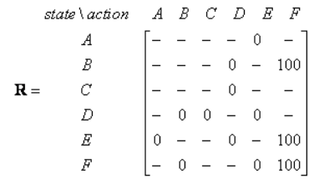
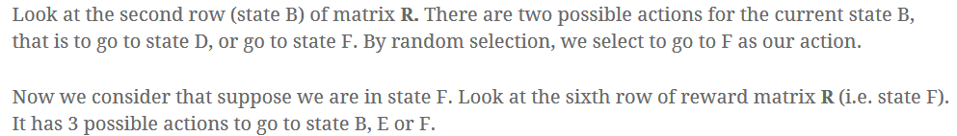


Slide 9
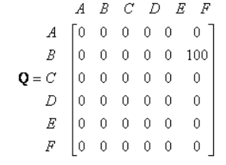
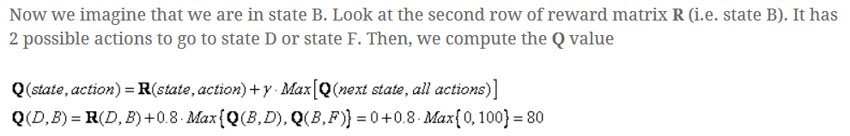

Slide 10
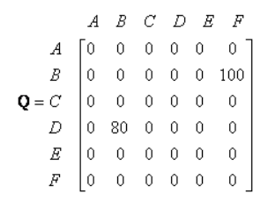

Slide 11
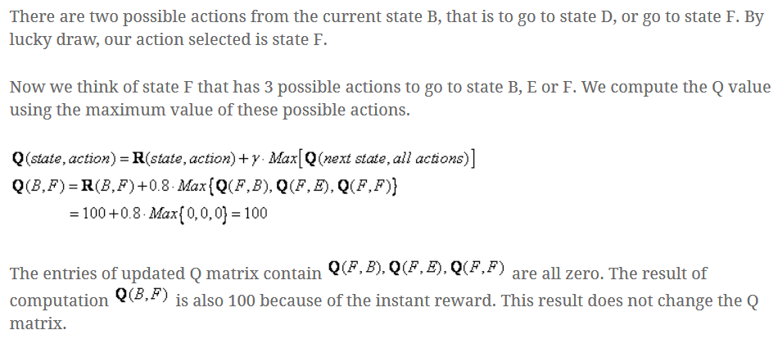

Slide 12
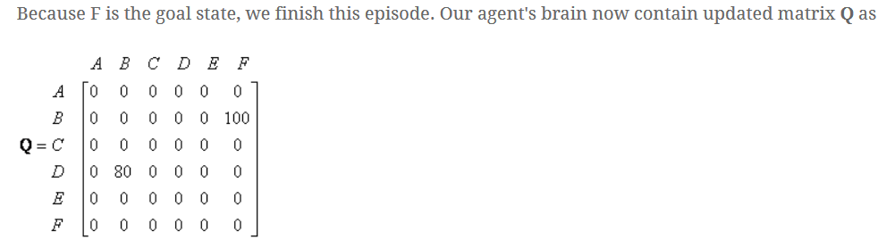
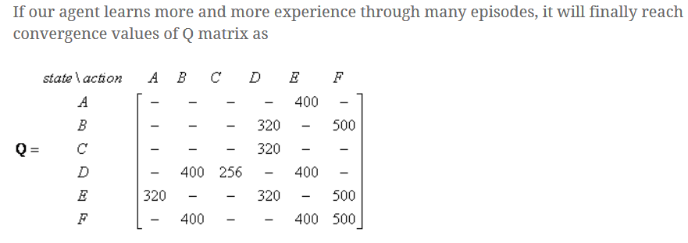

Slide 13
